Slide 1


Robotics Workshop Week 7 Digital Bubble Level
Notes:
Hello everyone, welcome to the 7th robotics workshop,
Today well be looking at some new and fairly complex devices to make a digital bubble level.
Who here does or has done computer science? Most of you great, im asking because today we will be using binary and hexadecimal to communicate with these devices.
Just as a quick reminder as to how these workshops work, you’ll get into groups of 2-4 go through the worksheet after I’ve gone through a quick presentation on the content, then if you get stuck feel free to ask me or Patrick any of your questions.
Now as I said, this is a fairly complex worksheet, denoted by the yellow color, so if you're not comfortable with the concepts or simply want to do a previous worksheet, you can.
So what are these devices we’re using today?

Slide 2
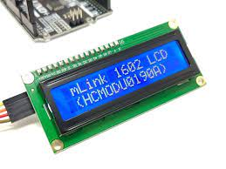
Liquid Crystal Display (LCD)
Notes:
The first one you’ll be using is an LCD, it’s a relatively simple display with 2 rows of 16 characters.
It runs with 5V and is controlled via 8 data pins, each of these corresponds to a bit where 8 bits makes a byte, you will be writing some code to set these pins on and off in a sequence to send data to the LCDs, luckily to keep your wiring slightly less confusing, you only need to use 4 of the 8 data pins for basic instructions.
And just a fun question, who remembers what 4 bits are called collectively? A nibble, correct>

Slide 3
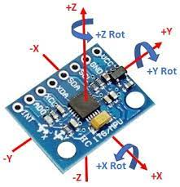
MPU6050 (Motion Processing Unit)
Notes:
The next device you’ll be using is called a Motion Processing Unit, this little thing measures acceleration and rotation in all 3 axes.
As you can see in the diagram, that would be up and down, left and right, forwards and backwards.
It uses 3.3V for power so try not to confuse that with the 5V needed or the LCD and instead of binary for communication it uses a protocol called I2C, this only uses 2 pins, one for data and one for a clock.
With that out of the way lets get started!

